Slide 1
Check Error Handler User Manual

Slide 2
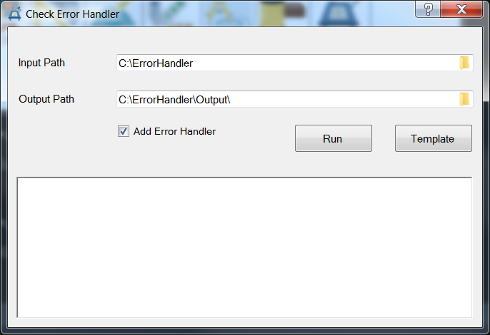
Check Error Handler
Purpose : To check function if exist error handler.
GUI

Slide 3
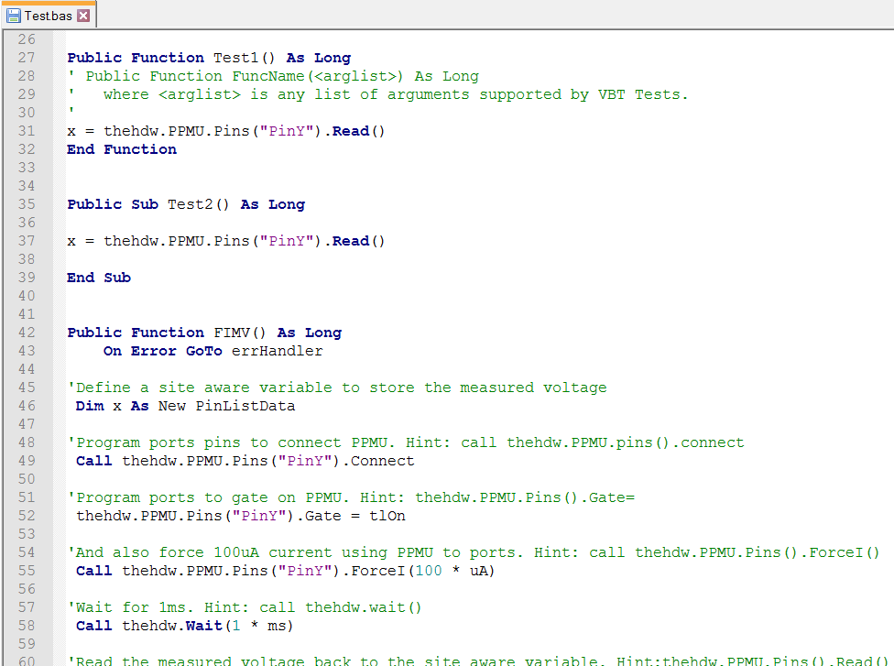
Check Error Handler
If you check the checkbox “Add Error Handler”,
tool will generate the new bas file and add error handler.

Slide 4
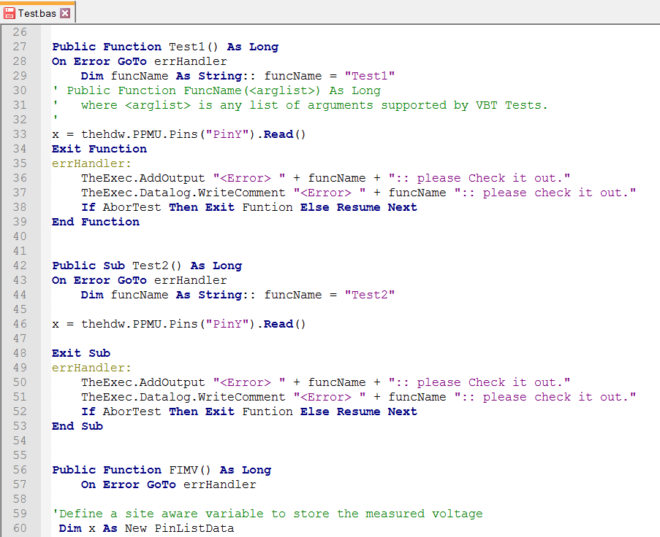
Check Error Handler

Slide 5
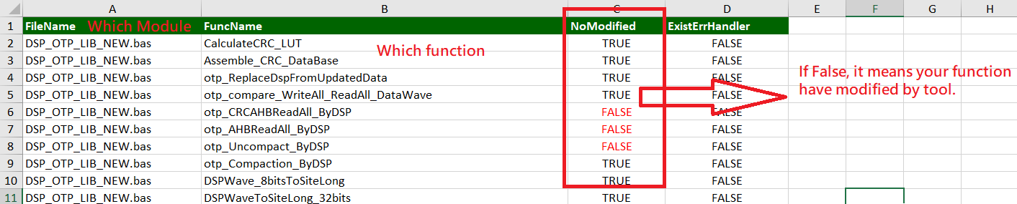
Check Error Handler
Report:

